Slide 1
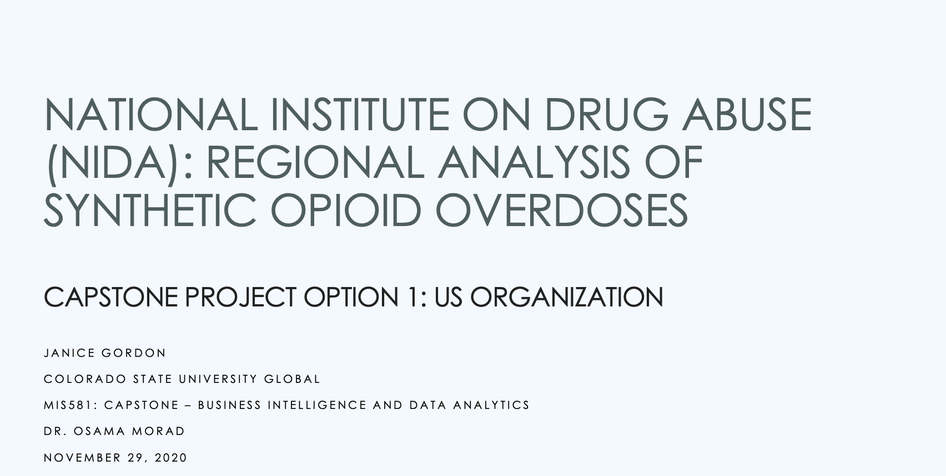
Notes:
Hi, my name is Janice Gordon and I’m going to talk to you today about my Capstone project. I chose the National Institute on Drug Abuse “NIDA” and the fight against opioid addiction as my topical area.
I was inspired to chose this topic after reading an article about Sara Wittner, a young 32 year old suffering from Substance Use Disorder. Sara was in treatment on the road to recovery when the COVID pandemic hit. Her treatment appointments were continually delayed, and her treatment support groups had ceased to meet (Hawryluk, 2020 ). Unfortunately, Sara died from an overdose the day before her next treatment appointment. After reading Sara’s story, I wondered how many others were struggling during the pandemic and if opioid addiction was increasing in the Denver area. How could tragedies like Sara’s be prevented? What kind of resources are available in different areas of the country. After some preliminary research, I came across the National Institute on Drug Abuse “NIDA”. I was interested in what kind of data analytical NIDA uses to inform resource allocations for research and prevention.
This presentation will cover:
NIDA Overview
Opioid Crisis Background
Synthetic Opioids
Hypothesis
Analysis Methods & Results
Study Limitations & Recommendations
To begin, let’s take a deeper look at the NIDA organization

Slide 2

NIDA has four primary goals:
Identifying the causes and consequences of long-term addiction and drug use;
Developing effective drug abuse prevention strategies;
Developing new treatments for Substance Use Disorder (SUD); and
Increasing the impact of its research programs to improve public health (NIDA, 2020).
Notes:
NIDA originated in 1935 as part of the U.S. Public Health Service in Lexington, KY and later became the Addiction Research Center in 1948 (NIH, 2018). NIDA was formalized in 1974 as the Federal lead for data collection and research on the prevention, treatment, training, and services on drug abuse and continues today as an institute within NIH (NIH, 2018).
Goals:
And … NIDA is the lead agency coordinating the opioid crisis for all U.S. federal organizations (NIDA, n.d.).

Slide 3
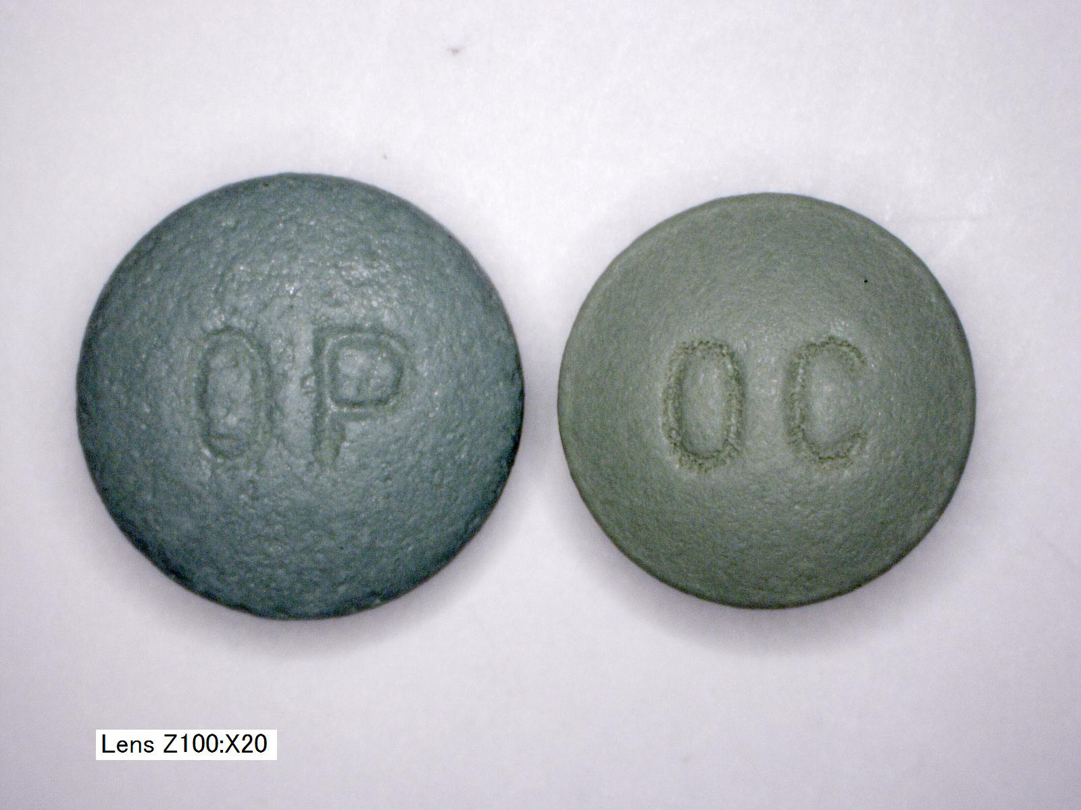
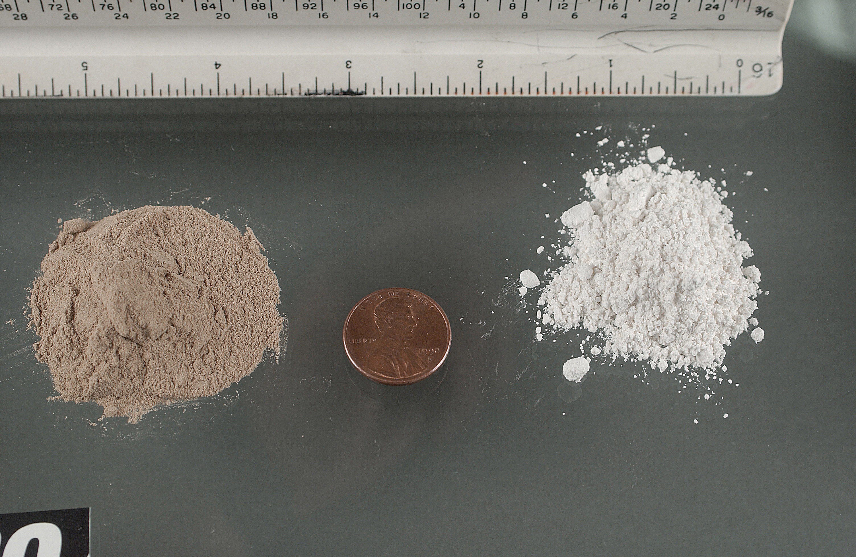
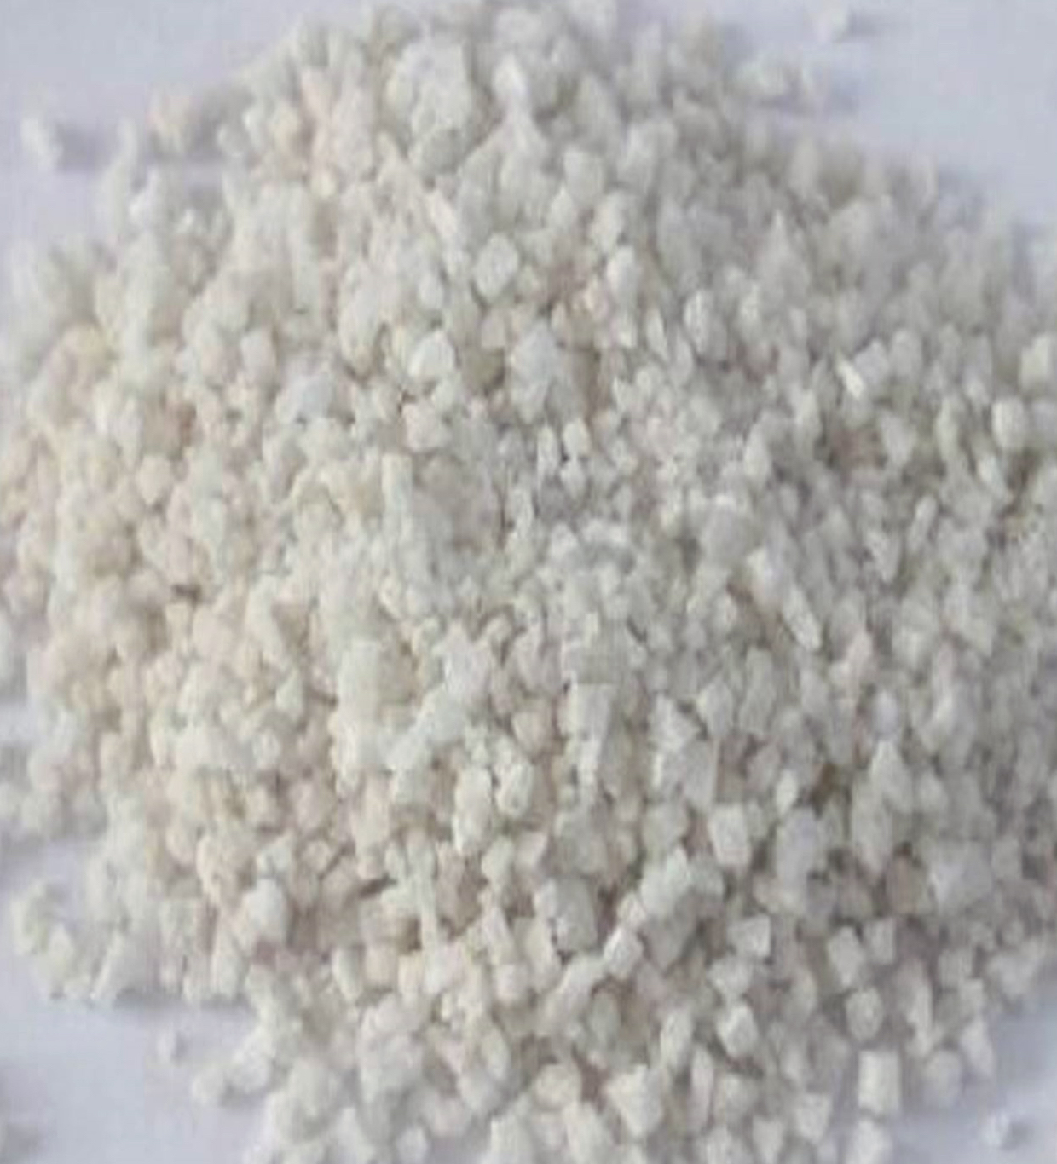
Opioid Crisis Background
1
1990 to 2010
2
2010 to 2013
3
2013 to Present
OxyContin 40mg
Powder Heroin
Fentanyl Crystals
Prescription Opioids
Heroin
Synthetic Opioids
(CDC, 2020)
Notes:
Now let’s talk about the evolution of the Opioid crisis in the United States.
The opioid crisis has seen three distinct phases:
The first phase started in the early 90s with the overprescribing and subsequent addiction to prescription opioids, and subsequent rises in overdose deaths;
The second phase started with rises in heroin overdose deaths starting in 2010; and
The current phase, phase 3, started around 2013 with the alarming rise in synthetic opioid overdose deaths (CDC, 2020).
Each phase of the opioid crisis has been interrelated with the preceding phase and has led to new and rapidly evolving challenges (CDC, 2020).
Studies have correlated the prescription opioid crisis to the increased use of non-medical prescription opioids and then subsequently to heroin, in essence catalyzing phase two of the epidemic (Mars, Rosenblum, & Ciccarone, 2019).
How did the rise in synthetic opioids start and why are they so dangerous?

Slide 4

What are Synthetic Opioids?
Synthetic Opioids – manufactured in labs and are much more potent than natural opioids (heroin, morphine) (NIDA, 2019)
Fentanyl and fentanyl derivatives produced in the illicit drug market are called Illicitly Manufactured Fentanyl (IMF) and serve no medical purpose (NIDA, 2019)
Lethal in VERY SMALL doses (DEA, 2016)
Heroin
Carfentanil
Fentanyl
Notes:
Synthetic Opioids such as Fentanyl were originally prescribed for extreme pain, post surgery or for end-of-life palliative care (NIDA, 2019) and are far more potent (50-100x more powerful than morphine).
Fentanyl and Fentanyl derivatives started to be manufactured within the illicit drug market and serve no medical purpose, these drugs are called IMF – Illicitly Manufactured Fentanyl.
IMF is lethal in very small doses, if you look at the image on the right you can see the lethal doses for Heroin, and Carfentanil, and Fentanil on the right. As you can see in this close—up, the lethal amounts would be virtually undetectable when mixed with other substances, making it extremely dangerous.
Drug users are often unaware they are taking it, leading to unintentional overdoses (Mars, Rosenblum, & Ciccarone, 2019)
Fentanyl also posed hidden Dangers to First Responders and Law Enforcement if inhaled (BAART Programs, 2019)
How did Fentanyl first get introduced into the street drug market?

Slide 5
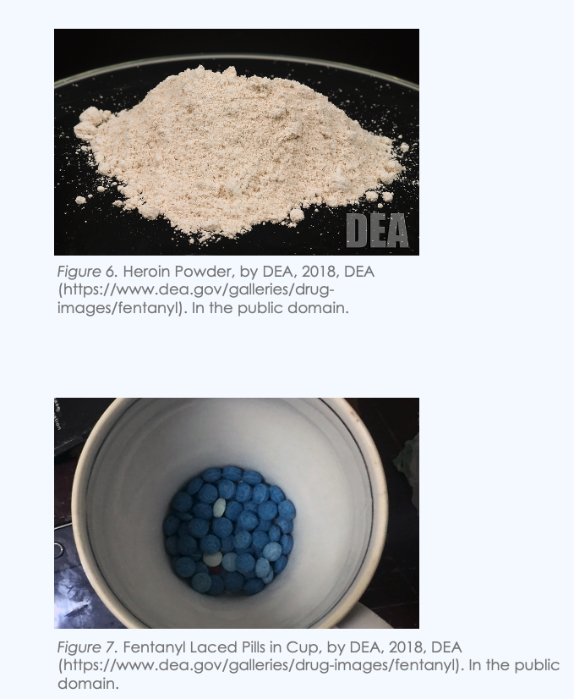
Fentanyl in the Northeast Heroin Market
Fentanyl is cheap to produce and more potent
Fentanyl started being “cut into” powder heroin in the Northeast (Zoorob, 2019)
Primarily “powder” from Chinese and Mexican Transnational Criminal Organization at the beginning of the crisis (DEA, 2020)
Now, the supply of fentanyl is coming from multiple sources and ingredients are shipped through the mail (China, Mexico, India, Canada)
Notes:
Because IMF is so cheap to produce (cheaper than heroin), drug traffickers started to mix it in with heroin, it mixed particularly well with the powder heroin. Because powder heroin was so common in drug supplies in the Northeast many studies have correlated this spike in fatal overdoses in the Northeastern US (Zoorob, 2019). In contrast, western states primarily had access to “black tar” heroin from Columbia, which has distinctly different color and texture from powder heroin, making the infusion of powder fentanyl more difficult.
Unfortunately, the drug market is now more complex with new traffickers and drug mediums now flooding into the U.S (DEA, 2020).
Now fentanyl is commonly mixed with not just heroin, but also with cocaine, meth, and hidden in counterfeit pills such disguised as Oxycotin and other prescription opioids (NIDA, 2019).
With all these changes in the illicit drug market, are there new geographic trends in US overdose rates moving beyond the Northeast?

Slide 6
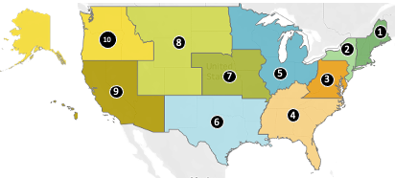
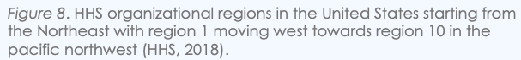
Hypothesis
There are statistically significant differences in fentanyl related overdose deaths between at least one pair of HHS regions for the time period 2013 through 2018.
HHS Regions
Notes:
My Hypothesis for this research project is that “there are statistically significant differences in fentanyl related overdose deaths between at least one pair of HHS regions within the third wave of the opioid crisis 2013-2018.
The Map shows the different HHS Regions in the United States, Starting in New England with Region 1… moving west to Region 10, which include Washington State and Alaska.

Slide 7
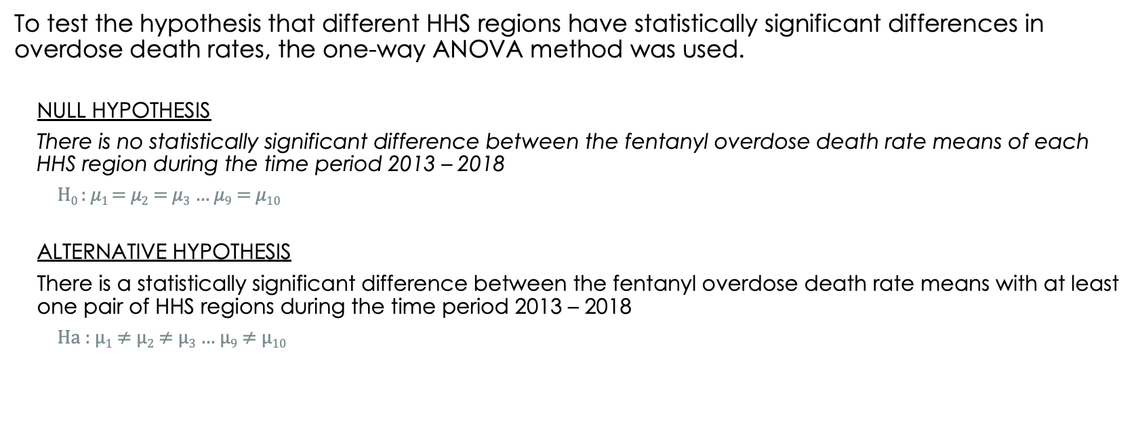
Hypothesis testing USING One-Way ANOVA
To test the hypothesis that different HHS regions have statistically significant differences in overdose death rates, the one-way ANOVA method was used.
NULL HYPOTHESIS
There is no statistically significant difference between the fentanyl overdose death rate means of each HHS region during the time period 2013 – 2018
H₀ : $μ1$ = $μ2$ = $μ3$ $…$ $μ9$ = $μ10$
ALTERNATIVE HYPOTHESIS
There is a statistically significant difference between the fentanyl overdose death rate means with at least one pair of HHS regions during the time period 2013 – 2018
Ha : $μ1$ $≠$ $μ2$ $≠$ $μ3$ $…$ $μ9$ $≠$ $μ10$
Notes:
A one-way ANOVA test was used to evaluate the null and alternative hypotheses.
The null hypothesis states that there are no statistically significant differences in overdose rates between regions.
The alternative hypothesis states there are statistically significant differences (which supports my main hypothesis)
Next we’ll look at the process used to test these hypotheses.

Slide 8
Method
1
Query & Download Data
2
Import, Prepare, & Explore Data
3
One-way ANOVA Analysis
4
5
Tukey’s HSD Post-hoc Analysis
Tableau Data Visualization

Slide 9
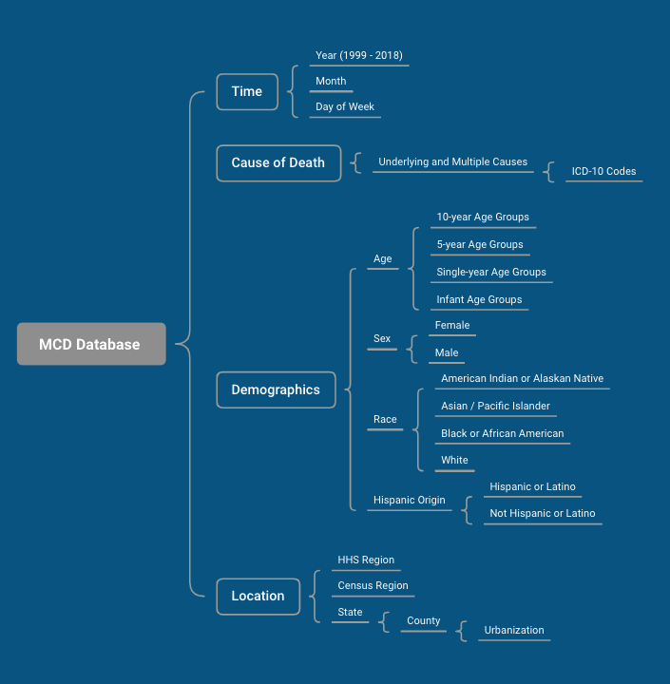
1. Query & Download Data
CDC Multiple Cause of Death (MCD) Database
Query Parameters:
Years: 2013-2018
Cause of Death ICD Codes: T40.R (other synthetic narcotics), X40-45 (accidental poisoning codes), X60-64 (intentional self-poisoning), and Y11-14 (poisoning undetermined intent).
Location: HHS Region
Data Retrieved:
Year
Total Deaths
Population
Age Adjusted Death Rate per 100,000 people
Percentage of Total Deaths
Notes:
The data used for this project was downloaded from CDC Wide-ranging Online Data for Epidemiologic Research (WONDER) research system provides public access to data regarding public health, including mortality data. The Multiple Cause of Death (MCD) database can be accessed and queried through WONDER, providing detailed data gathered from death certificates, including a primary cause of death, any additional causes, and demographic data (NCHS, 2020)
The query interface allows researchers to query by Year, ICD Codes (cause of death codes), and by location and various demographic characteristics. The data model on the left shows the structure of the data.
For this project, I downloaded data for the years 2013-2018, from each HHS Region, where the primary or additional cause of death was listed as T40.R (other synthetic narcotics) which is how fentanyl poisoning is recorded.
The datasets downloaded included: Year, Total Deaths, Population, Age Adjusted Death Rates, and the percentage of total deaths.

Slide 10
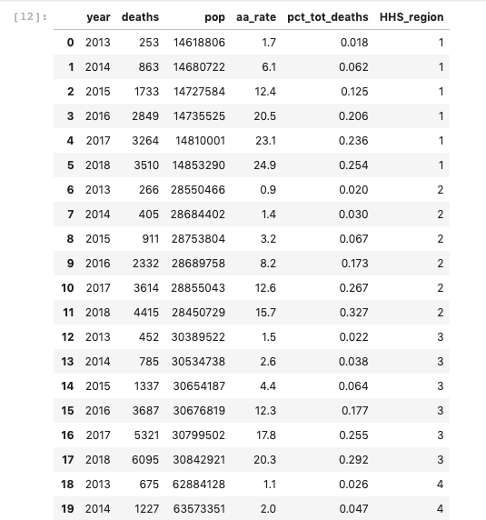
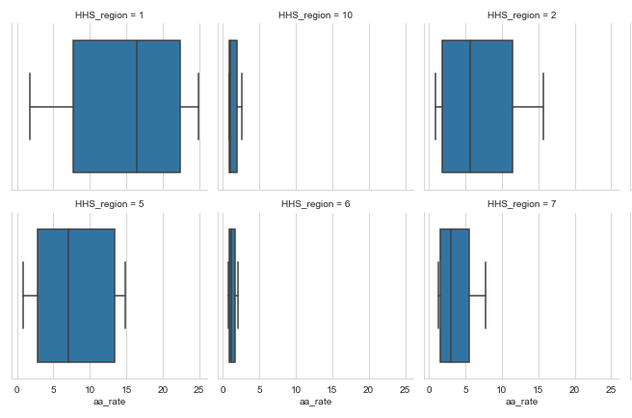
2. Import, Prepare, & Explore Data
All Project Code in GitHub at:
https://github.com/janice-gordon/Regional-Disparities-in-Overdose-Death-Rates
Tools Used
Python (pandas, statsmodels, scipy, seaborn)
JupyterLab Notebook
Process
Tab separated txt files downloaded from MCD
Imported into pandas DataFrame
Summary statistics
Exploratory plots (density plots, boxplots)
Notes:
The tools I used for this project included a JupyterLab notebook with a Python 3 kernel, and the pandas, statsmodels, scipy, and seaborn libraries for my analysis.
First, I imported the tab delimited data files into pandas DataFrames.
Next, I created summary statistics and created plots to examine the variables of interest.
Once the data was prepped and organized, I could proceed with my analysis.

Slide 11
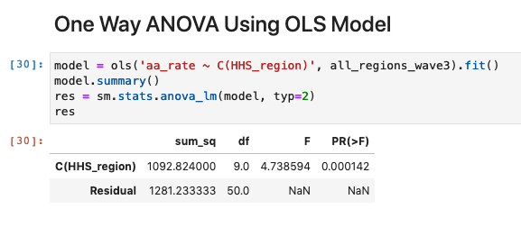
3. One-way ANOVA Analysis
Null Hypothesis is Rejected!
Notes:
I performed a One Way ANOVA analysis using the statsmodel OLS method.
The p-value for the F-statistic was 0.000142, well below the threshold of <0.05
This means that I can reject the Null Hypothesis!
Now I know that not all regional death rates are statistically equivalent, and that at least one pair has statistically significant differences in means.
But which regions are different?

Slide 12
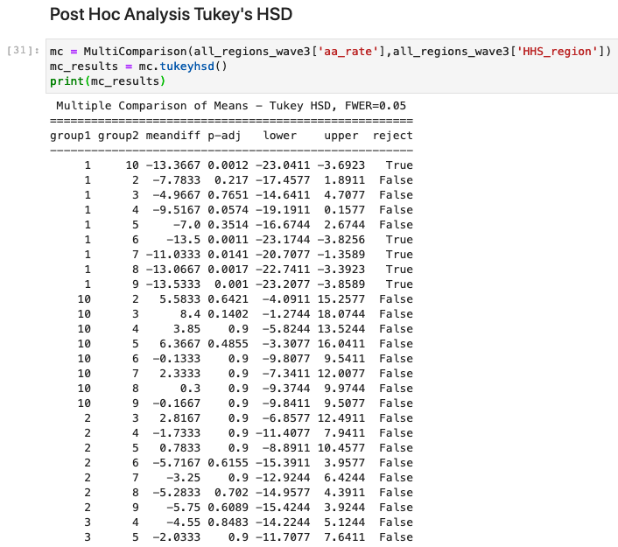
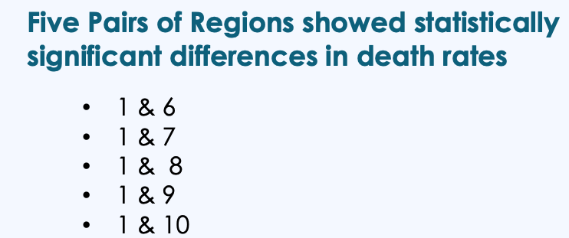
4. Tukey’s HSD Post-hoc Analysis
HHS Regions
Notes:
In order to find out which regions are statistically different; I ran a Post Hoc analysis using Tukey’s Honestly Significant Difference (HSD) test
The results showed that Region 1 had statistically significant differences from Regions, 6,7,8, and 9. No other pairs showed significant differences.
Next, we’ll visualize these results using Tableau.

Slide 13
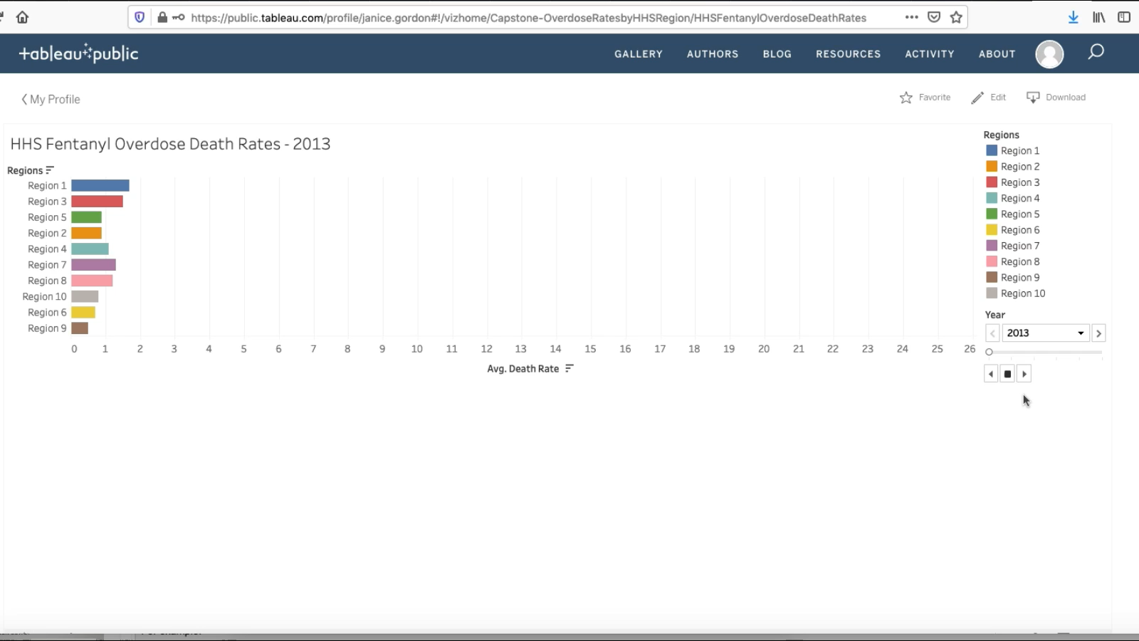
5. Tableau Data Visualization 1
Notes:
Data was exported as a csv file and imported into Tableau public.
This video shows a “race” animation of fentanyl overdose rates starting in 2013 for all regions.

Slide 14
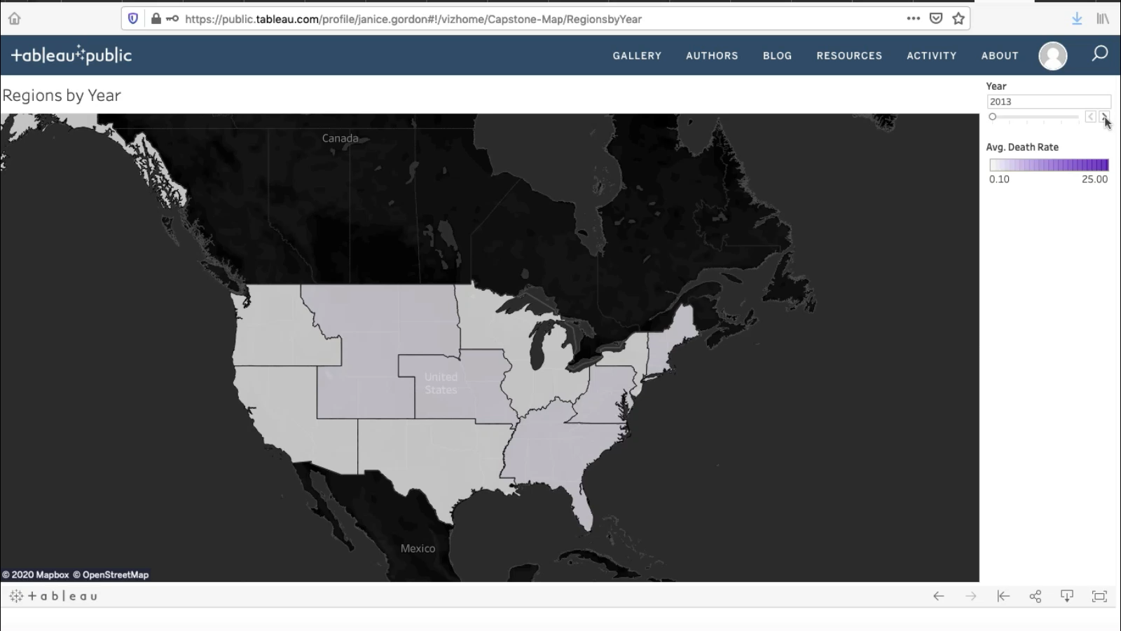
5. Tableau Data Visualization 2
Notes:
This video shows the spread and darkening of the purple color from the northeast (region 1) slowly moving west.

Slide 15
Study Limitations & Recommendations
Limitations
Currency of data
Questionable accuracy of death certificates
Compares very large regional areas – might miss local hot spots
Recommendations
Add non-fatal overdose data from hospital data
Look at correlations with drug seizure data (FOIA Request)
Drill down into smaller geographic areas – states, counties, urban hot spots
Notes:
While my results did result in the rejection of the null hypothesis, there were several limitations.

Slide 16
conclusion
ANOVA results allowed the rejection of the Null hypothesis, supporting my hypothesis that there are statistically significant differences in death rates between HHS Regions.
Post-hoc analysis revealed that Region 1 in the Northeast showed statistically significant differences in fentanyl related overdose death rates (higher) compared to the western Regions 6, 7, 8, 9, and 10.
These results indicate the importance of understanding regional trends in fentanyl overdose data for NIDA, in order to:
make informed, data-driven decisions on funding future research and prevention efforts
to equitably place resources where they are needed most
to get ahead of the ever-changing opioid crisis and make a difference in our communities
Notes:
In summary …
Through data-driven decision making
With equitable distribution of resources
Along with public education efforts
To help improve the treatment of Substance Use Disorder (Prekupec, Mansky, & Baumann, 2017)
With this I will conclude my presentation, thank you!

Slide 17
References
BAART Programs. (2019, March 21). Why Is Fentanyl So Dangerous? https://baartprograms.com/why-is-fentanyl-so-dangerous/
CDC. (2020, March 19). Opioid Overdose: Understanding the Epidemic. https://www.cdc.gov/drugoverdose/epidemic/index.html
DEA. (2020). Fentanyl Flow to the United States. DEA Intelligence Report, DEA-DCT-DIR-008-20, https://www.dea.gov/sites/default/files/2020-03/DEA_GOV_DIR-008-20%20Fentanyl%20Flow%20in%20the%20United%20States_0.pdf
DEA. (2016). Public Safety Alert From Drug Enforcement Administration Counterfeit Hydrocodone Tablets Containing Fentanyl. https://www.dea.gov/press-releases/2016/04/01/public-safety-alert-drug-enforcement-administration-counterfeit
Hawryluk, M. (2020, June 28). Broomfield woman’s suspected overdose spotlights hidden deaths of the COVID-19 pandemic. https://www.denverpost.com/2020/06/28/covid-deaths-mental-health-suicide-addiction/
Mars, S. G., Rosenblum, D., & Ciccarone, D. (2019). Illicit fentanyl in the opioid street market. desired or imposed? Addiction, 114(5), 774–780.

Slide 18
References
NCHS. (2020, May 19). Multiple Cause of Death 1999-2018: Help. https://wonder.cdc.gov/wonder/help/mcd.html
NIDA. (n.d.). Drug Topics. https://www.drugabuse.gov/drug-topics
NIDA. (2019, February). Fentanyl Drug Facts. https://www.drugabuse.gov/publications/drugfacts/fentanyl
NIH. (2018, November 28). The NIH Almanac: National Institute on Drug Abuse (NIDA). https://www.nih.gov/about-nih/what-we-do/nih-almanac/national-institute-drug-abuse-nida
Prekupec, M. P., Mansky, P. A., & Baumann, M. H. (2017). Misuse of Novel Synthetic Opioids. Journal of Addiction Medicine, 11(4), 256–265. https://doi.org/10.1097/adm.0000000000000324
Zoorob, M. (2019). Fentanyl shock: The changing geography of overdose in the United States. International Journal of Drug Policy, 70, 40–46. https://doi.org/10.1016/j.drugpo.2019.04.010

